Slide 1
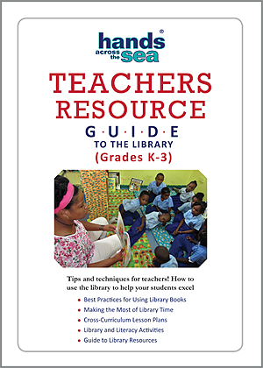

Speed Dating Book Activity +
How to Write a Book Blurb
Notes:
*In this video, I will explain how to engage in the Speed Dating Book Activity as well as how to write a book blurb.

Slide 2
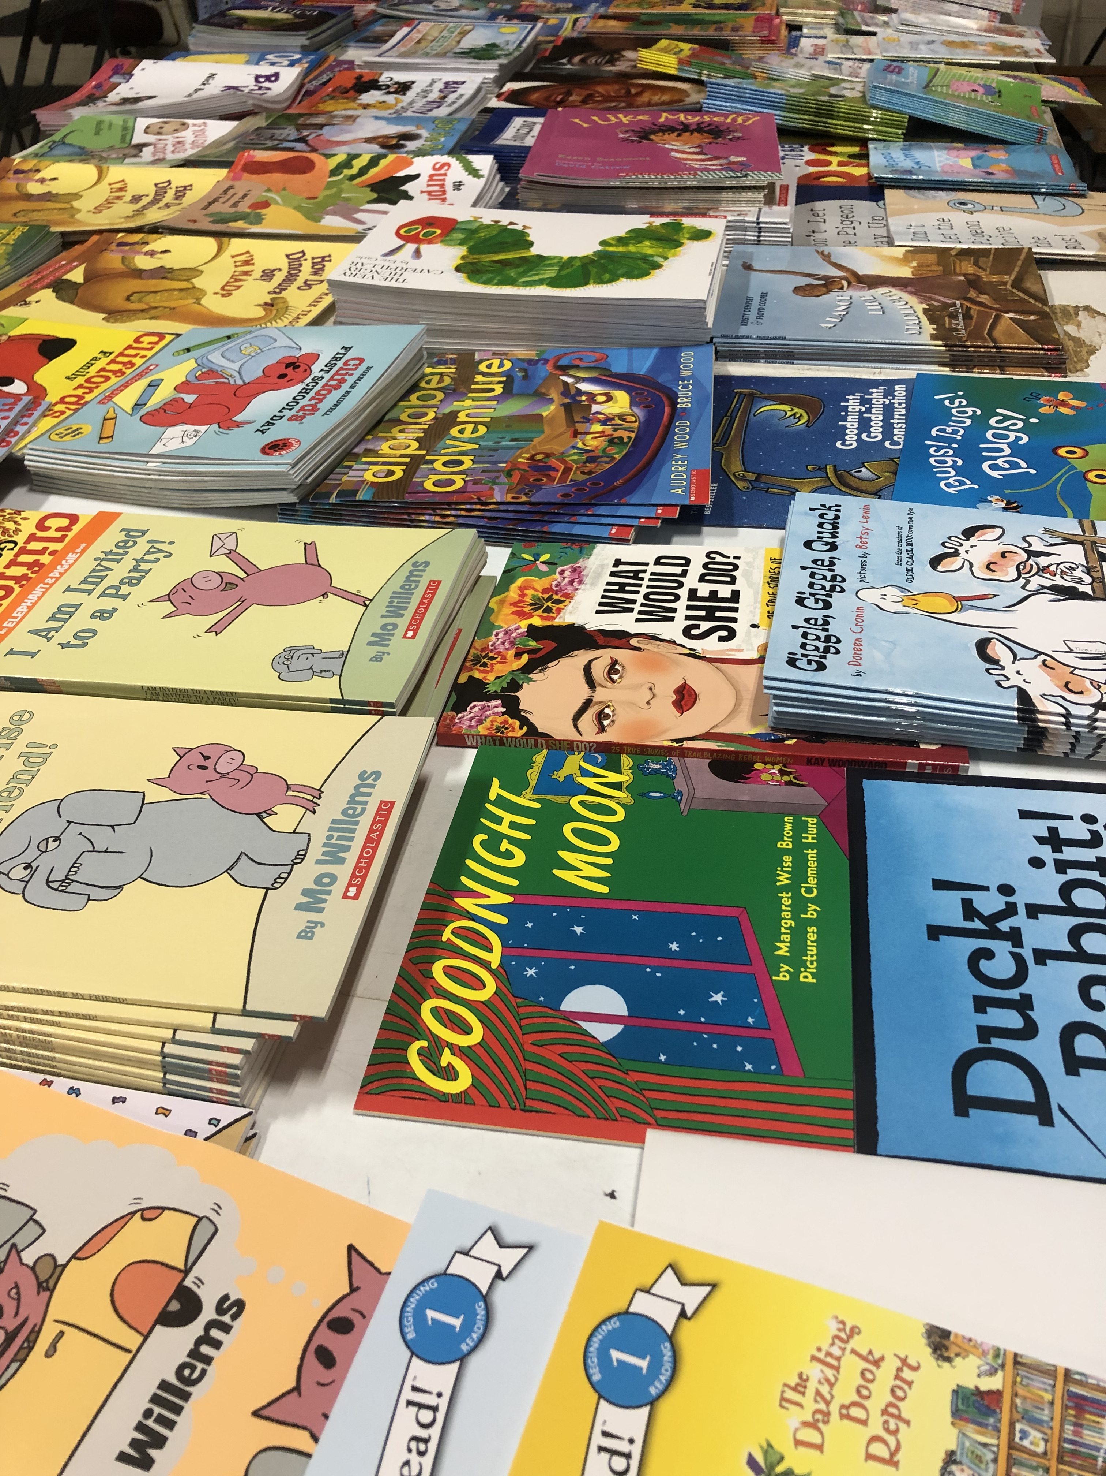
Reasons for doing the
Speed Dating Book Activity:
Do you know what books are in your school library?
What curriculum could you teach with this book?
Notes:
*Do you know what books are in your school library?
Often teachers are not aware of the many different books that are in their school library. The more familiar we are with the books our school library has available, the better off we will be as reading teachers for our students.
Not only will we be able to recommend books we’ve seen in the library to our own students, but we will also now know of books about topics we are teaching in our curriculum, read-aloud books we can use with our students in the classroom, and anchor texts that we can utilize in our lesson plans to compliment the reading skills we are teaching! This is a win-win for all of us!

Slide 3
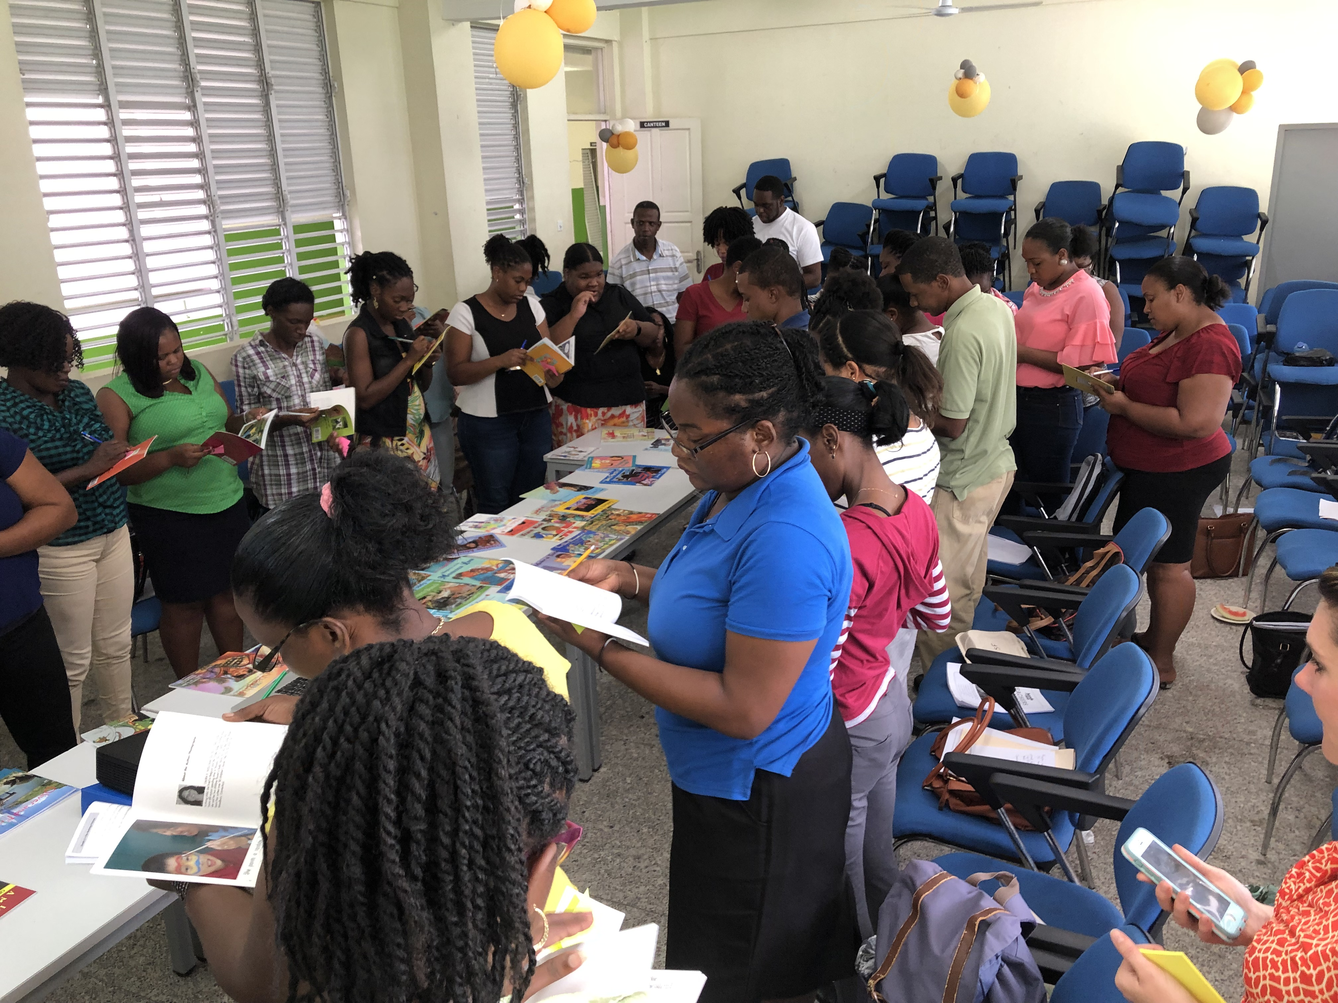
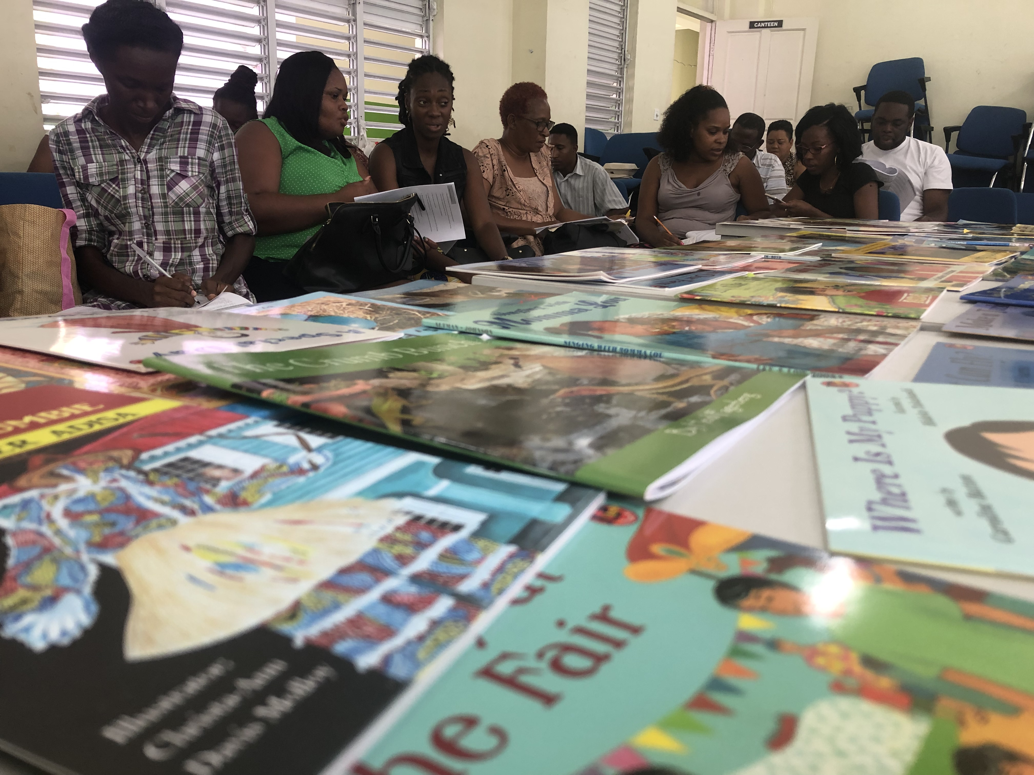
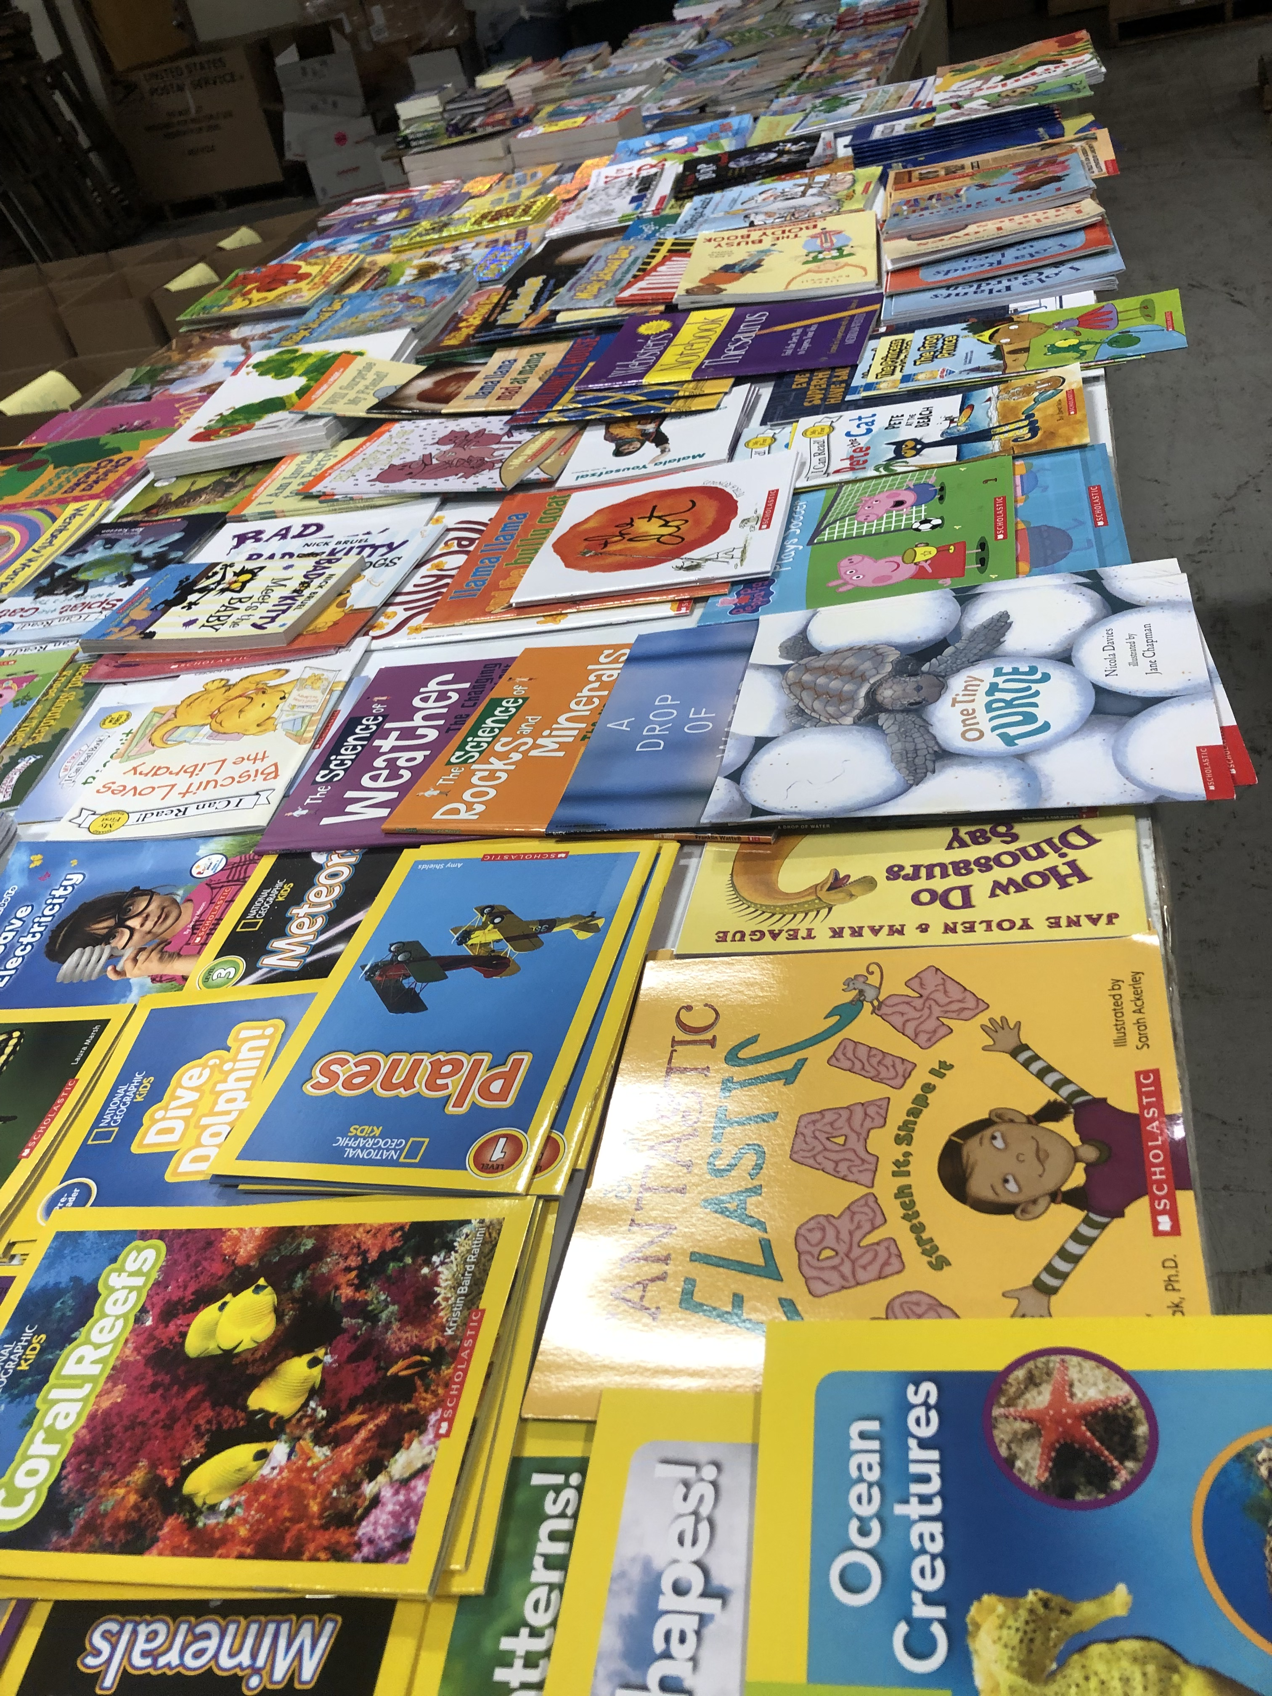

How to:
Speed Dating Book Activity
Get to know the books that may be “hiding” in your school’s library!
60 seconds to browse the book and consider how it can be used to teach your curriculum.
“Shopping List” to take notes.
Notes:
*Your library is full of books you may have never seen before—both chapter books and picture books. The speed dating book activity simply allows teachers the opportunity to quickly browse their school library’s book collection to get to know the books that may be ”hiding” in your school’s library.
*Super simple! Lay out about 30-50 books of various genres and reading levels on two long tables or desks. *Teachers are given a shopping list to take with them that they can jot down notes on during the activity. *Teachers will begin the activity by standing in front of one book at the table and will have *60 seconds to browse the book directly in front of them.

Slide 4

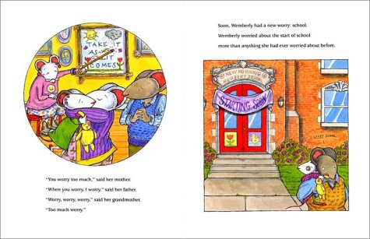
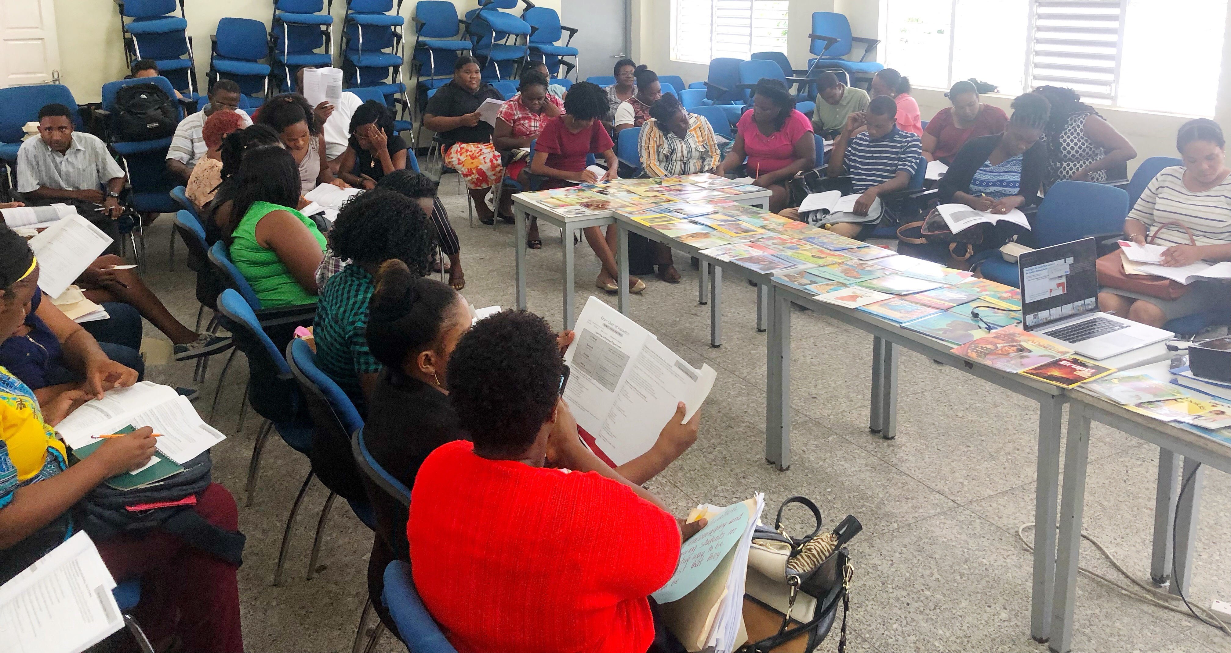
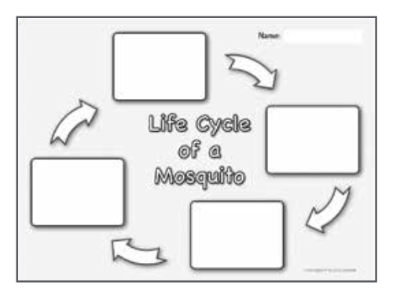
Directions: Speed Dating Book Activity
Could I use the “speed dating” book activity with my students?
Notes:
*During the 60 seconds, teachers will *scan the back of the book if there is a synopsis, *leaf through the pages, and jot down the title on their *shopping lists. They can also take note of what the book is about and *how the book could be used to teach an aspect of their current curriculum. *Some books will compliment the curriculum *perfectly—others, we will have to be more creative with! *But by getting to know the books in your library, you are training your brain to think about these books as teaching tools.
*So 60 seconds with one book.

Slide 5
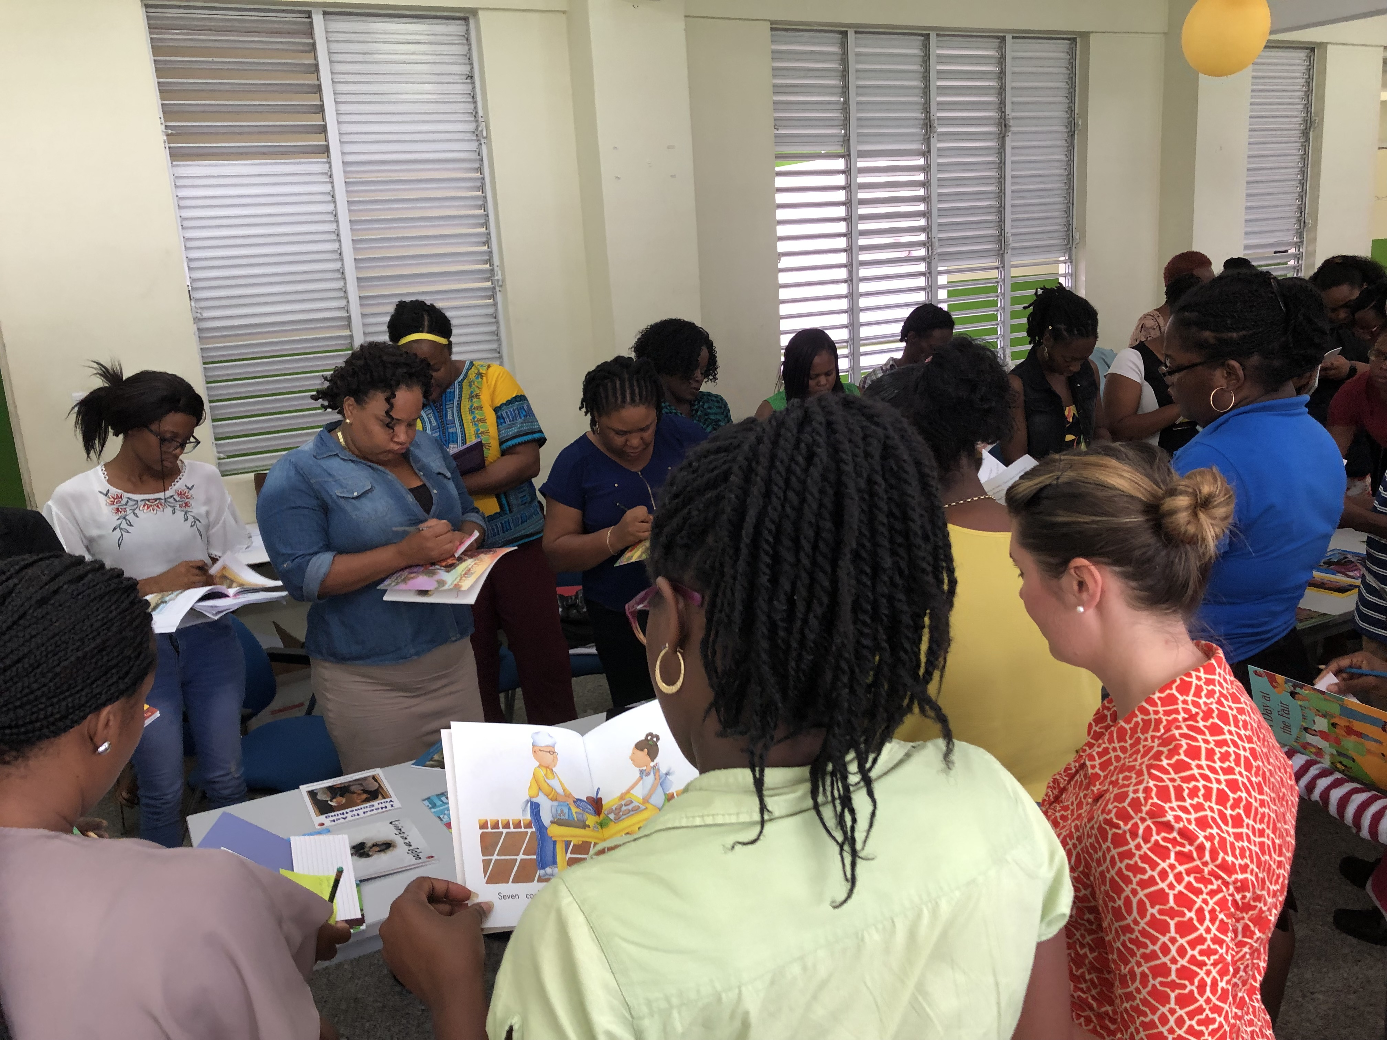
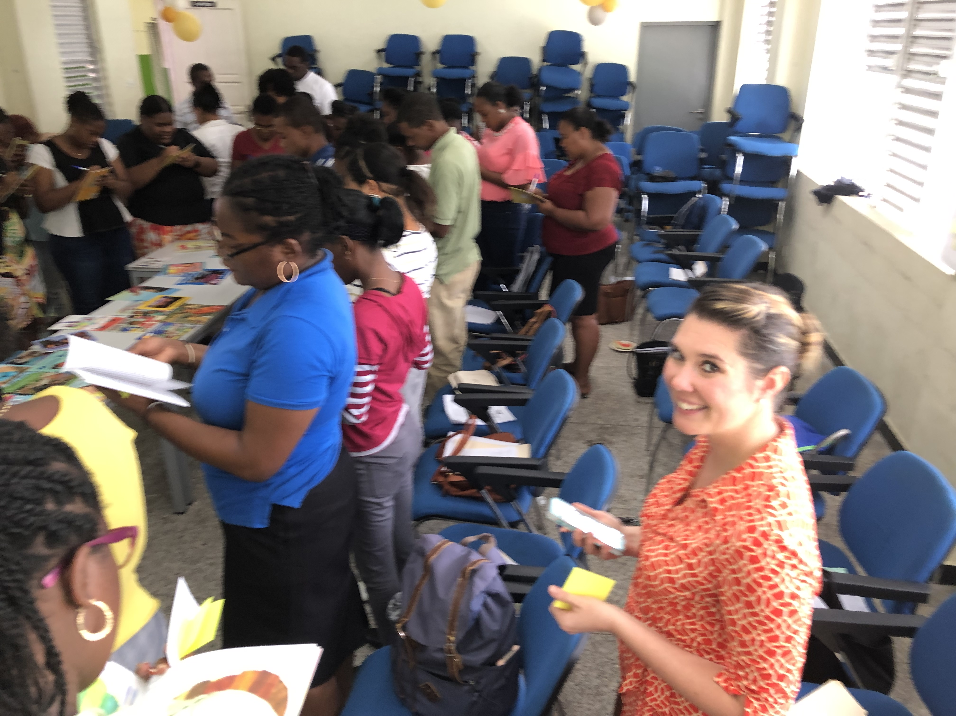
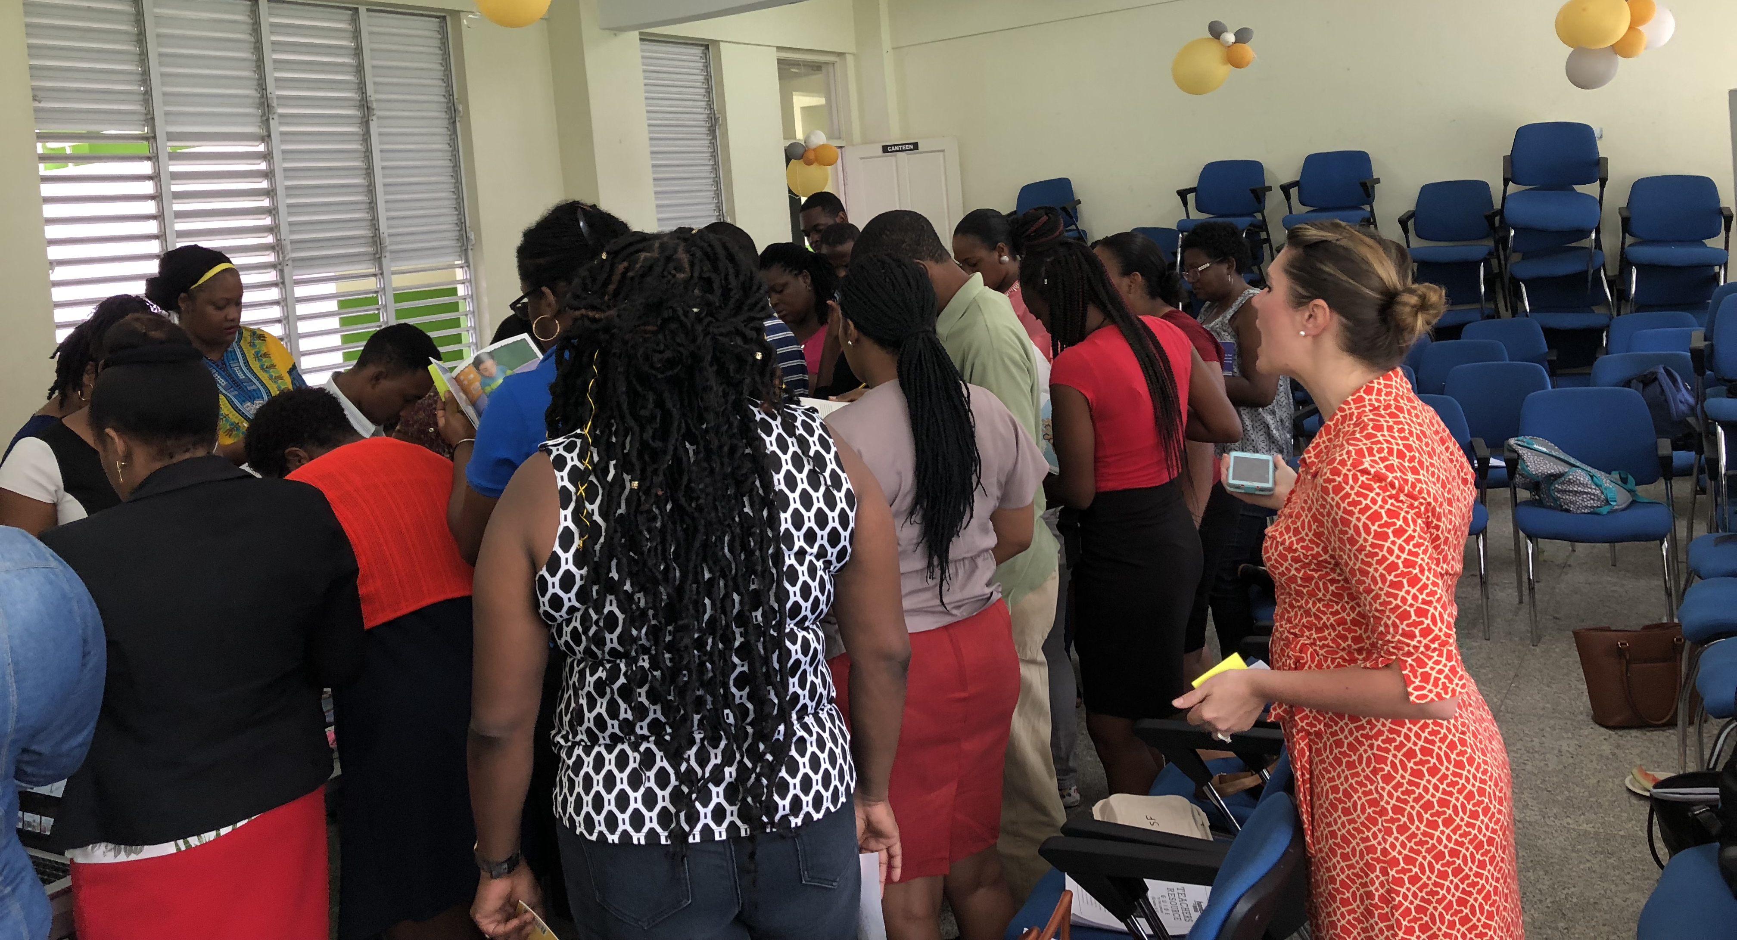


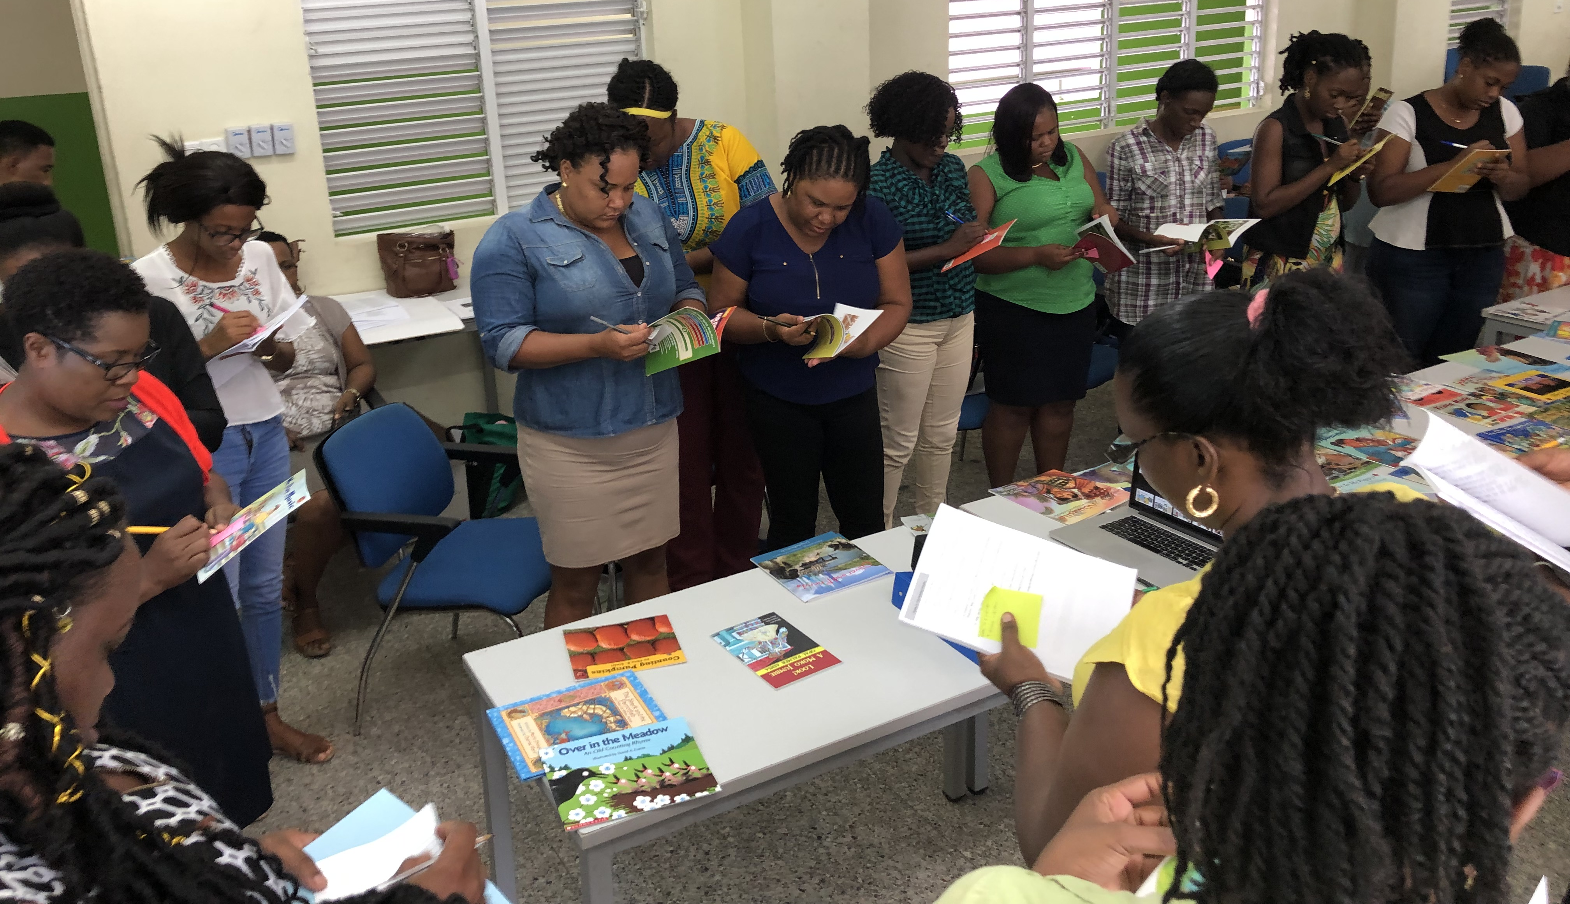
Speed Dating Book Activity
Notes:
*Facilitators will time the activity and let you know when to begin with your first book, they will give you a *time check at 30 seconds, and remind everyone *to “stop” once the time is up.
*After the first round, teachers will *take a step to their right (*moving around the table counter-clockwise) to browse another book. *Facilitators will announce the next round to begin and teachers will browse their second book the same way, using their shopping list to take quick notes. Depending on the time allotment for this activity, teachers may have the opportunity to browse as many as 8 or 10 books during the activity. Once the activity is over, return to your seat with your shopping list and be ready to share with a partner about your findings. Pause the video to conduct the Speed Dating Book Activity.

Slide 6
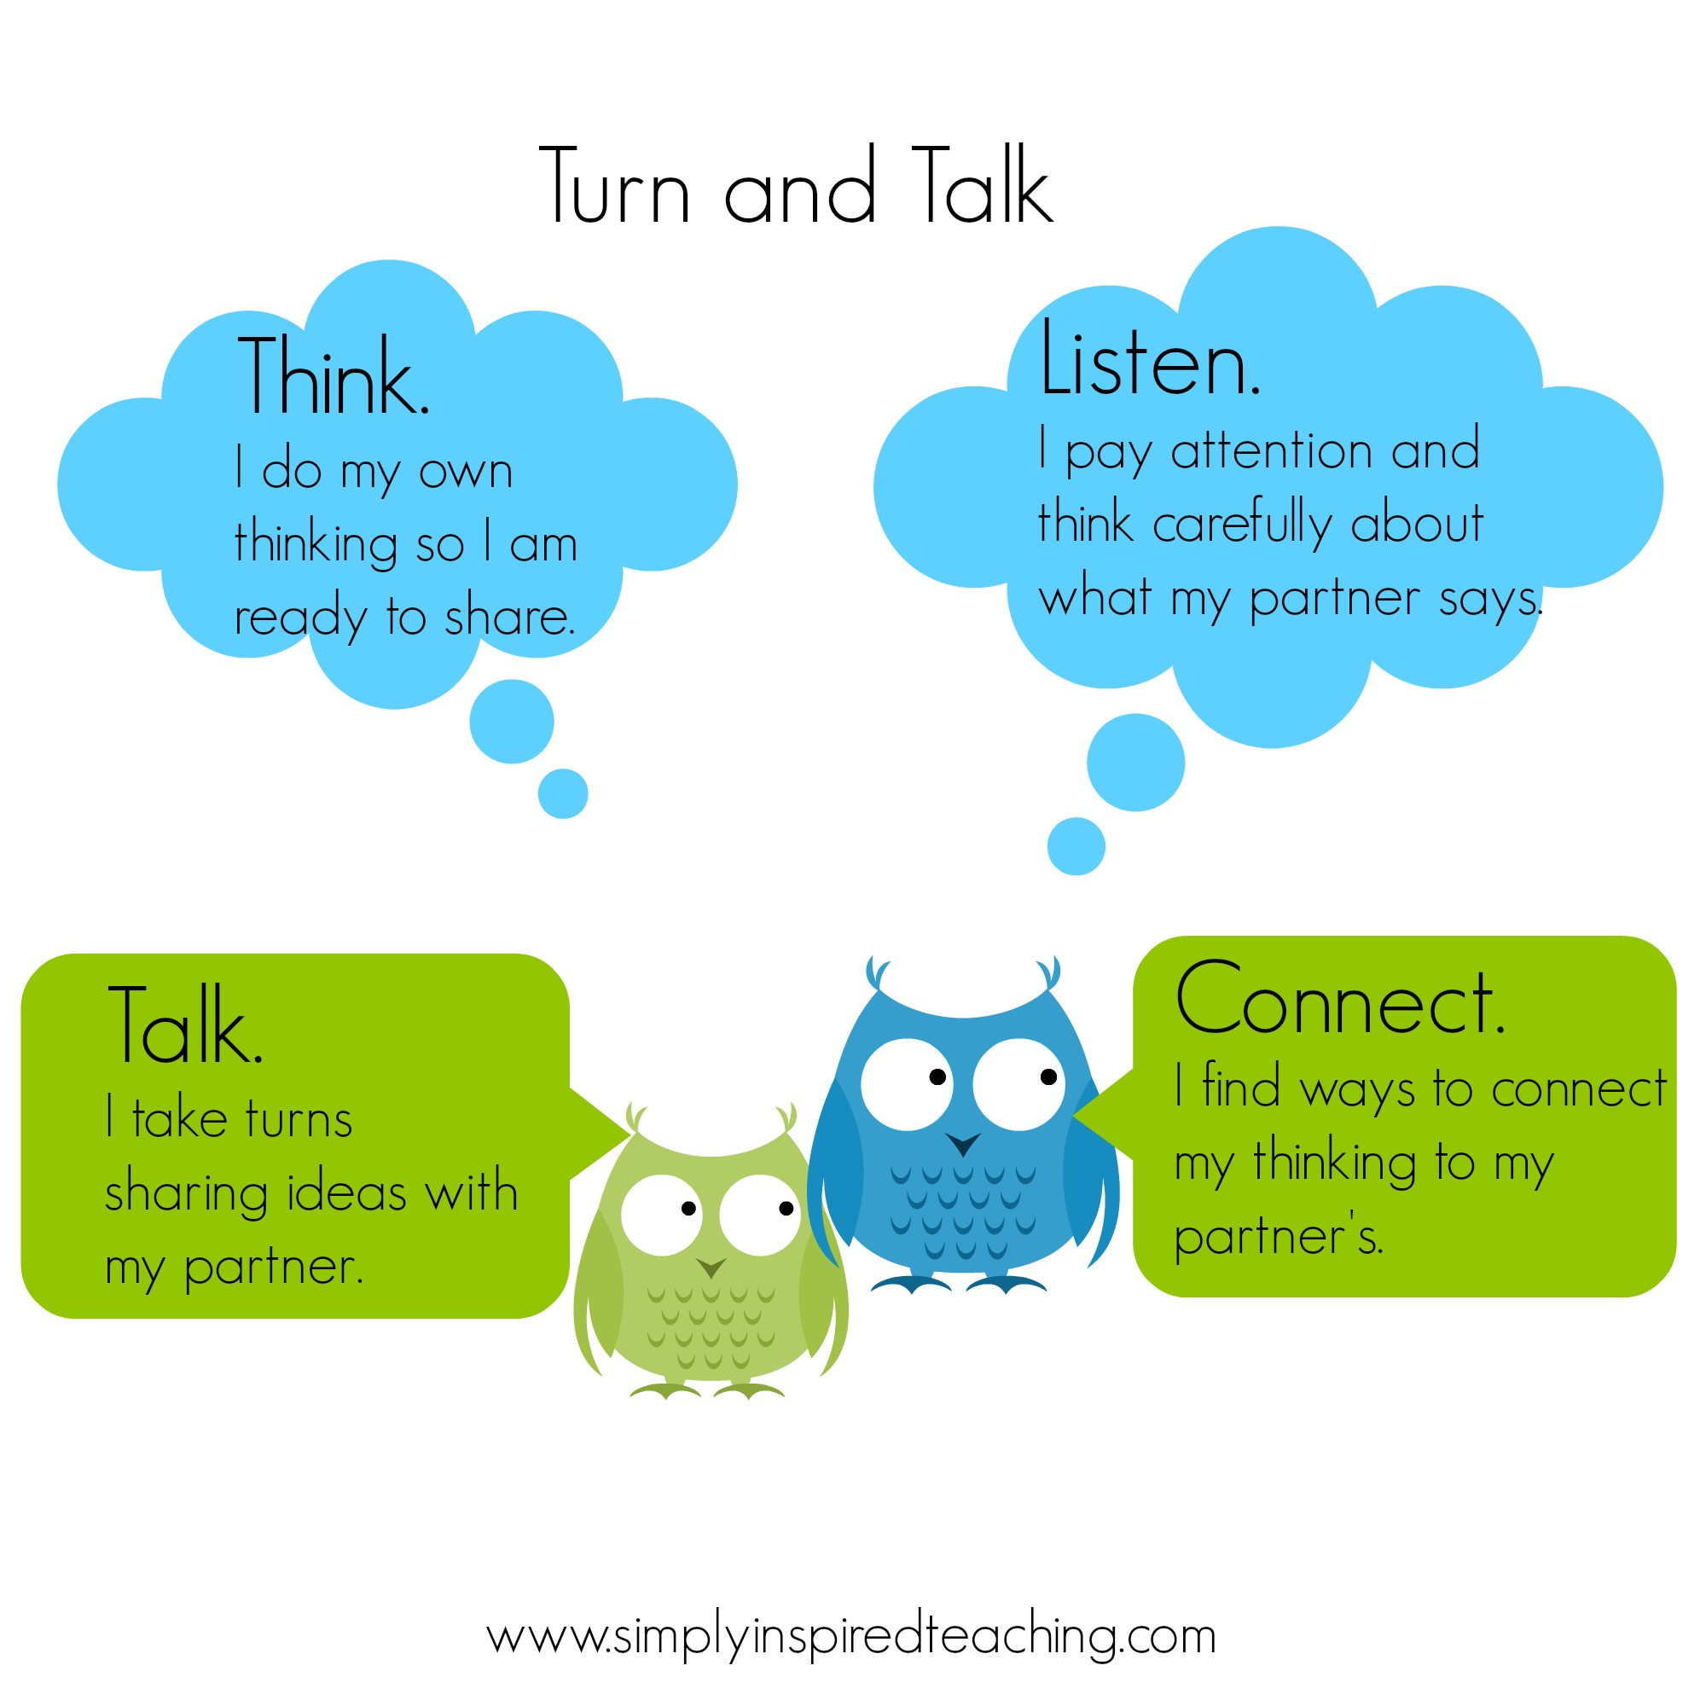
Talk and Turn:
What book did you “discover” that you can see yourself using to teach with?
Notes:
*A “Talk and Turn” is an activity you can easily do with your students in which each participant thinks, talks, listens, and connects with a partner. First, do your own thinking so you are ready to share. Next, take turns sharing ideas with your partner. Then, listen by paying attention and thinking carefully about what your partner says. And finally, find ways to connect your thinking to your partner’s.
Let’s try it out by answering the question: What book did you discover during the Speed Dating Book activity that you can see yourself using to teach with? Use your shopping list notes to share your thoughts about one book. Talk and turn with your partner for 60 seconds. On your mark, get set, talk…

Slide 7
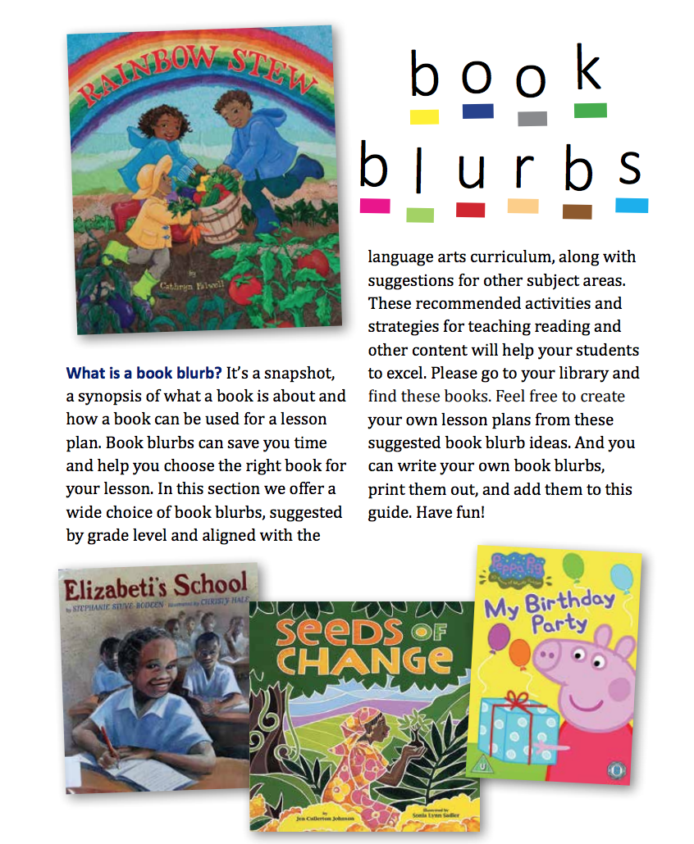
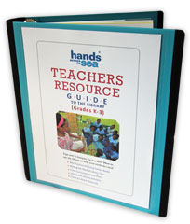
Notes:
*Now let’s talk about writing a book blurb. The Book Blurb section in the Teachers Resource Guide lists books that can be used by various grade levels to teach about certain topics from our curriculum.

Slide 8
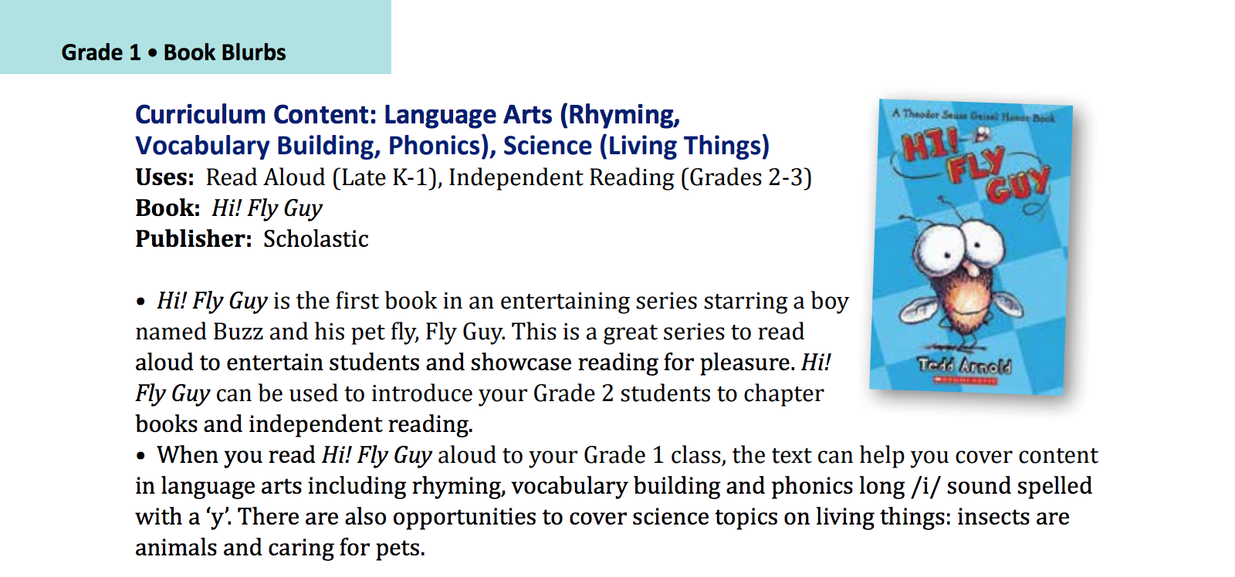
Notes:
*Let’s take a look at this one together and discuss what you notice about it after reading it. Pause the video and resume it after a quick discussion about your findings.

Slide 9

Book Blurbs Include:
Write Book Blurb to add to the TRG today!
Curriculum Content | Brief list (2-3 ideas)
Uses, book title, publisher | Read Aloud, Shared Reading, Independent Reading, Reluctant Readers, Centres, etc.
Short description | 1-2 sentence summary
How can a teacher use this book | Short list of how the book can be used to teach specific content, skills, strategies, etc.
Notes:
*Book Blubs include: the curriculum content (a brief list of 2 or 3 ideas). Uses means whether the book could be used as a read aloud, a shared reading book, an independent book activity, a good book for a reluctant reader, or a good book to use with centers. The book title is included and the publisher (which can be found on the title page of the book. But including the publisher on a BookBlurb is really optional). It is just optimal in helping other teachers locate this same book in their libraries for using it themselves in a lesson. A short description like a 1 to 2 sentence summary of the book so teachers know what the book is basically about or the main topic. And finally how the teacher can use this book—basically a short list of how the book can be used to teach specific content, skills, strategies, etc.
*Today, you will have the opportunity to write a Book Blurb to add to the TRG. You see, there is a reason why this publication is in a 3-ring binder. It’s meant to be added to by teachers like you!

Slide 10
Let’s write a Book Blurb together!
Story Elements, Conflict Resolution, Social Studies, and Science
Curriculum Content: ________________
Uses: _____________________
Book: ____________________
Publisher: ________________________
Shared Reading, Read-Aloud
Six Crows
Macmillan McGraw Hill
This book is about _____.
This book can be used to teach _____.
Six crows antagonize a wheat farmer, so he puts up a scary scarecrow to keep the crows away. The crows create a threatening kite in response until the wise owl encourages the crows and farmer to solve the problem through discussing their needs.
Story elements like character, setting, and plot can easily be identified, and this book can be used to teach sequencing order of events. This book is great to use when teaching conflict resolution and spurring class discussion. Six Crows is ideal for shared reading, because words are repeated often with picture prompts throughout the pages. Repeated words provide an opportunity for students to listen with a purpose.
Notes:
*So let’s practice and learn how to write one by writing a Book Blurb together. If you watched the Six Crows read-aloud video, then you are familiar with the book Six Crows by Leo Lionni. Feel free to follow along with the hand out if your facilitators have one for you. If not, just follow along on the screen. What curriculum content could we teach with this book? Just main ideas—a really brief list. *How about: Story Elements, Conflict Resolution, Social Studies, and Science? I have a list of these that you can choose from at the end that may help generate some ideas for you.
Ok, now uses—how can this book best be used in an activity or lesson? I used it for a read-aloud, but I also sprinkled in some of the shared reading concept, by pausing before reading words—to see if my students knew what word came next in the sentence as they were following along and thinking about the story. *So I am writing shared reading and read-aloud for this one.
*Book title is Six Crows. *Publisher is Macmillan McGraw Hill. I know that from opening up to the first page, the title page and scanning the bottom of that page where I can find the publisher name and logo. But remember, if you can’t find it—don’t worry about it. Leave it blank and move on.
The last two parts of the BookBlurb are: what the book is about and how the book can be used to teach. So I have these sentence starters to help coach me in writing these—feel free to use these sentence starters yourself to help you in making this writing process easier.
*This book is about six crows who antagonize a wheat farmer. So he puts up a scary scarecrow to keep the crows away. The crows create a threatening kite in response until the wise owl encourages the crows and farmer to solve the problem through discussing their needs. Short, simple. To the point. The teacher reading this knows what the book is about—doesn’t have to be detailed.
Ok, last part how this book can be used to teach. *Story elements like character, setting, and plot can easily be identified, and this book can be used to teach sequencing order of events. This book is great to use when teaching conflict resolution and spurring class discussion. Six Crows is ideal for shared reading, because words are repeated often with picture prompts throughout the pages. Repeated words provide an opportunity for students to listen with a purpose.

Slide 11

How to Write a Book Blurb
Step 1: Pick a book you are familiar with.
Step 2: Review/list how the book can be used to teach.
Step 3: Write a brief 1-2 sentence summary.
Step 4: Write a short list of what the book could
be used to teach (pick from the list to help you).
Step 5: Use the examples from the Teachers Resource
Guide as a model.
Notes:
*So now it is your turn! Use a blank piece of notebook paper or the back of your handout to write a Book Blurb.
Choose a book that you are familiar with. Preferably one from your Speed Dating Book activity that resonated with you. Review and list how the book can be used to teach. Write a brief 1 to 2 sentence summary. Then write a short list of what the book could be used to teach (you can pick from the list on the next slide to help you). *And of course, reference the Book Blurb section fro the Teachers Resource Guide to help you! These are models to support you in being able to do this yourself! Keep in mind, these are NOT detailed lesson plans. These are just a few ideas that you COULD turn into lesson plans if you wanted to, but they are meant to launch you and other teachers into using more books to teach with!

Slide 12
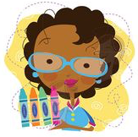
List of What Books Can Be Used to Teach:
active listening
thinking while reading
listening with a purpose
making predictions
rhyming patterns
use question words (who, what, where,
  when, how, why)
story elements (characters, setting, plot)
sequencing (ordering story events)
vocabulary
using context clues to determine meaning
identifying problem and solution
making text-to-self connections
drawing conclusions
identifying cause and effect
comparing and contrasting (similarities and differences)
relating to similar experiences
considering different perspectives/viewpoints
summarizing (retelling)
identifying main ideas
identifying elements of fiction and nonfiction
identifying author’s purpose
identifying author’s word choice/style
analyzing character (internal and external traits)
identifying words in the text with similar phonics’ sounds
science concepts
social studies concepts (citizenship, manners, history, economics, etc.)
math concepts
health concepts (family life)
Notes:
*Here is a list of some of the curriculum content you could teach to your students through the use of one of the books you browsed during the Speed Dating Book Activity. Feel free to use this list as you write your own!
active listening
thinking while reading
listening with a purpose
making predictions
rhyming patterns
use question words (who, what, where,
when, how, why)
story elements (characters, setting, plot)
sequencing (ordering story events)
vocabulary
using context clues to determine meaning
identifying problem and solution
making text-to-self connections
drawing conclusions
identifying cause and effect
comparing and contrasting (similarities and differences)
relating to similar experiences
considering different perspectives/viewpoints
summarizing (retelling)
identifying main ideas
identifying elements of fiction and nonfiction
identifying author’s purpose
identifying author’s word choice/style
analyzing character (internal and external traits)
identifying words in the text with similar phonics’ sounds
science concepts
social studies concepts (citizenship, manners, history, economics, etc.)
math concepts
health concepts (family life)

Slide 13
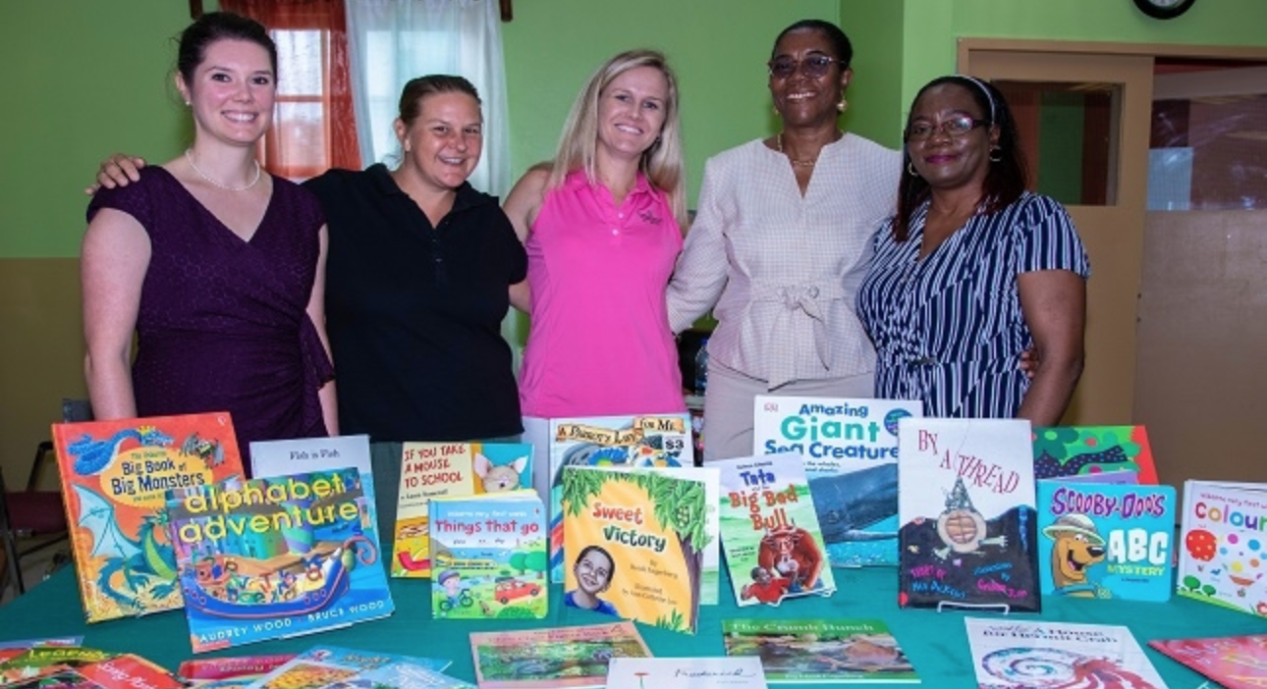
Share with other teachers!
Notes:
*Our goal is that you will USE these book blurbs yourself with your students. If this book is in your school library, go get it—check it out. Use the activity or activities you wrote down in your book blurb with your actual class and see how it goes. Then share what you did with other teachers at your school! The goal is to collaborate! Share ideas with others, steal one another’s ideas and keep experimenting with what works for you and for your students. Our goal is to see these books in your library USED—not just sitting on the shelf to look pretty. A successful library is one in which teachers and students are regularly checking in and out books, reading them, and teaching with them! You can do it! We believe in you!

